Slide 1
Web Presence - Wipro
Crafting & Compelling Website Analysis, Audit and Recommendations
Karthiga Elangovan – MBE12(BADM)

Slide 2
TASK 1: COMPANY SELECTION
I selected the company “Wipro” for this Web Presence project due to its expertise in IT services, innovation, and proven success across various industries.
Wipro Overview:
Leading global IT, consulting, and business process services company
Headquartered in Bangalore, India
Expertise in digital transformation, cloud services, AI, and cybersecurity
Serves industries like BFSI, healthcare, manufacturing, and retail
Strong focus on sustainability and innovation initiatives

Slide 3
TASK 2: PRODUCT AND SERVICE DESCRIPTIONS
Cloud: Scalable and on-demand computing resources that enable efficient data storage, processing, and application hosting.
Business Process: Streamlining and optimizing organizational workflows to improve efficiency, productivity, and customer satisfaction.
Cybersecurity: Protecting systems, networks, and data from unauthorized access, cyberattacks, and data breaches.
Data and Analytics: Extracting insights from vast datasets to drive informed decision-making and strategic planning.
Engineering: Designing and developing innovative solutions across software, hardware, and systems to solve complex problems.

Slide 4
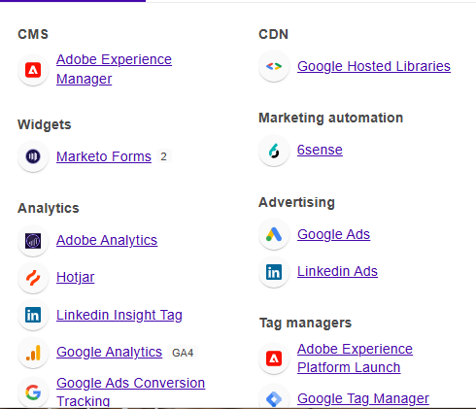
TASK 3 - WEBSITE PLATFORM IDENTIFICATION

Slide 5
TASK 4 - RESPONSIVE DESIGN TESTING
Tools Used: LightHouse, Gtmetrix, and BrowserStack.
Service page - Buttons and CTAs are properly aligned and fully functional on mobile.
Industries Page - Industry-specific content and visuals scaled effectively for mobile and desktop.
Insights Page - Blog posts, articles, and reports are easy to read and navigate on small screens.
About Page - Social media links and contact details are easily accessible on all screen sizes.
Contact Us Page - Forms are user-friendly and spaced for easy input on mobile.

Slide 6
TASK 5 - WEBSITE MISTAKES IDENTIFICATION
Suggestions to Wipro Websites
Avoid enormous network payloads
Use explicit width and height on image elements
Eliminate render-blocking resources
Avoid large layout shifts
Serve static assets with an efficient cache policy

Slide 7
TASK 6 - WEBSITE BEST PRACTICES LIST
Easy Navigation
Consistent Branding
Mobile-Friendly Design
Accessibility and SEO
Strong Calls to Action (CTAs)

Slide 8
TASK 7 - LANDING PAGE DESIGN
Objective: Lead generation for Wipro Fullstride Cloud.
Design Features:
A bold, attention-grabbing headline that quickly communicates the value of the service or product is used .
A clean, organized structure with plenty of white space to avoid overwhelming users.
I have ensure that the page adapts seamlessly to different screen sizes (desktop, mobile, tablet).
I have included Contact form.

Slide 9
TASK 7 - LANDING PAGE DESIGN
Landing page design
Services

Slide 10
THANK YOU

